Slide 1
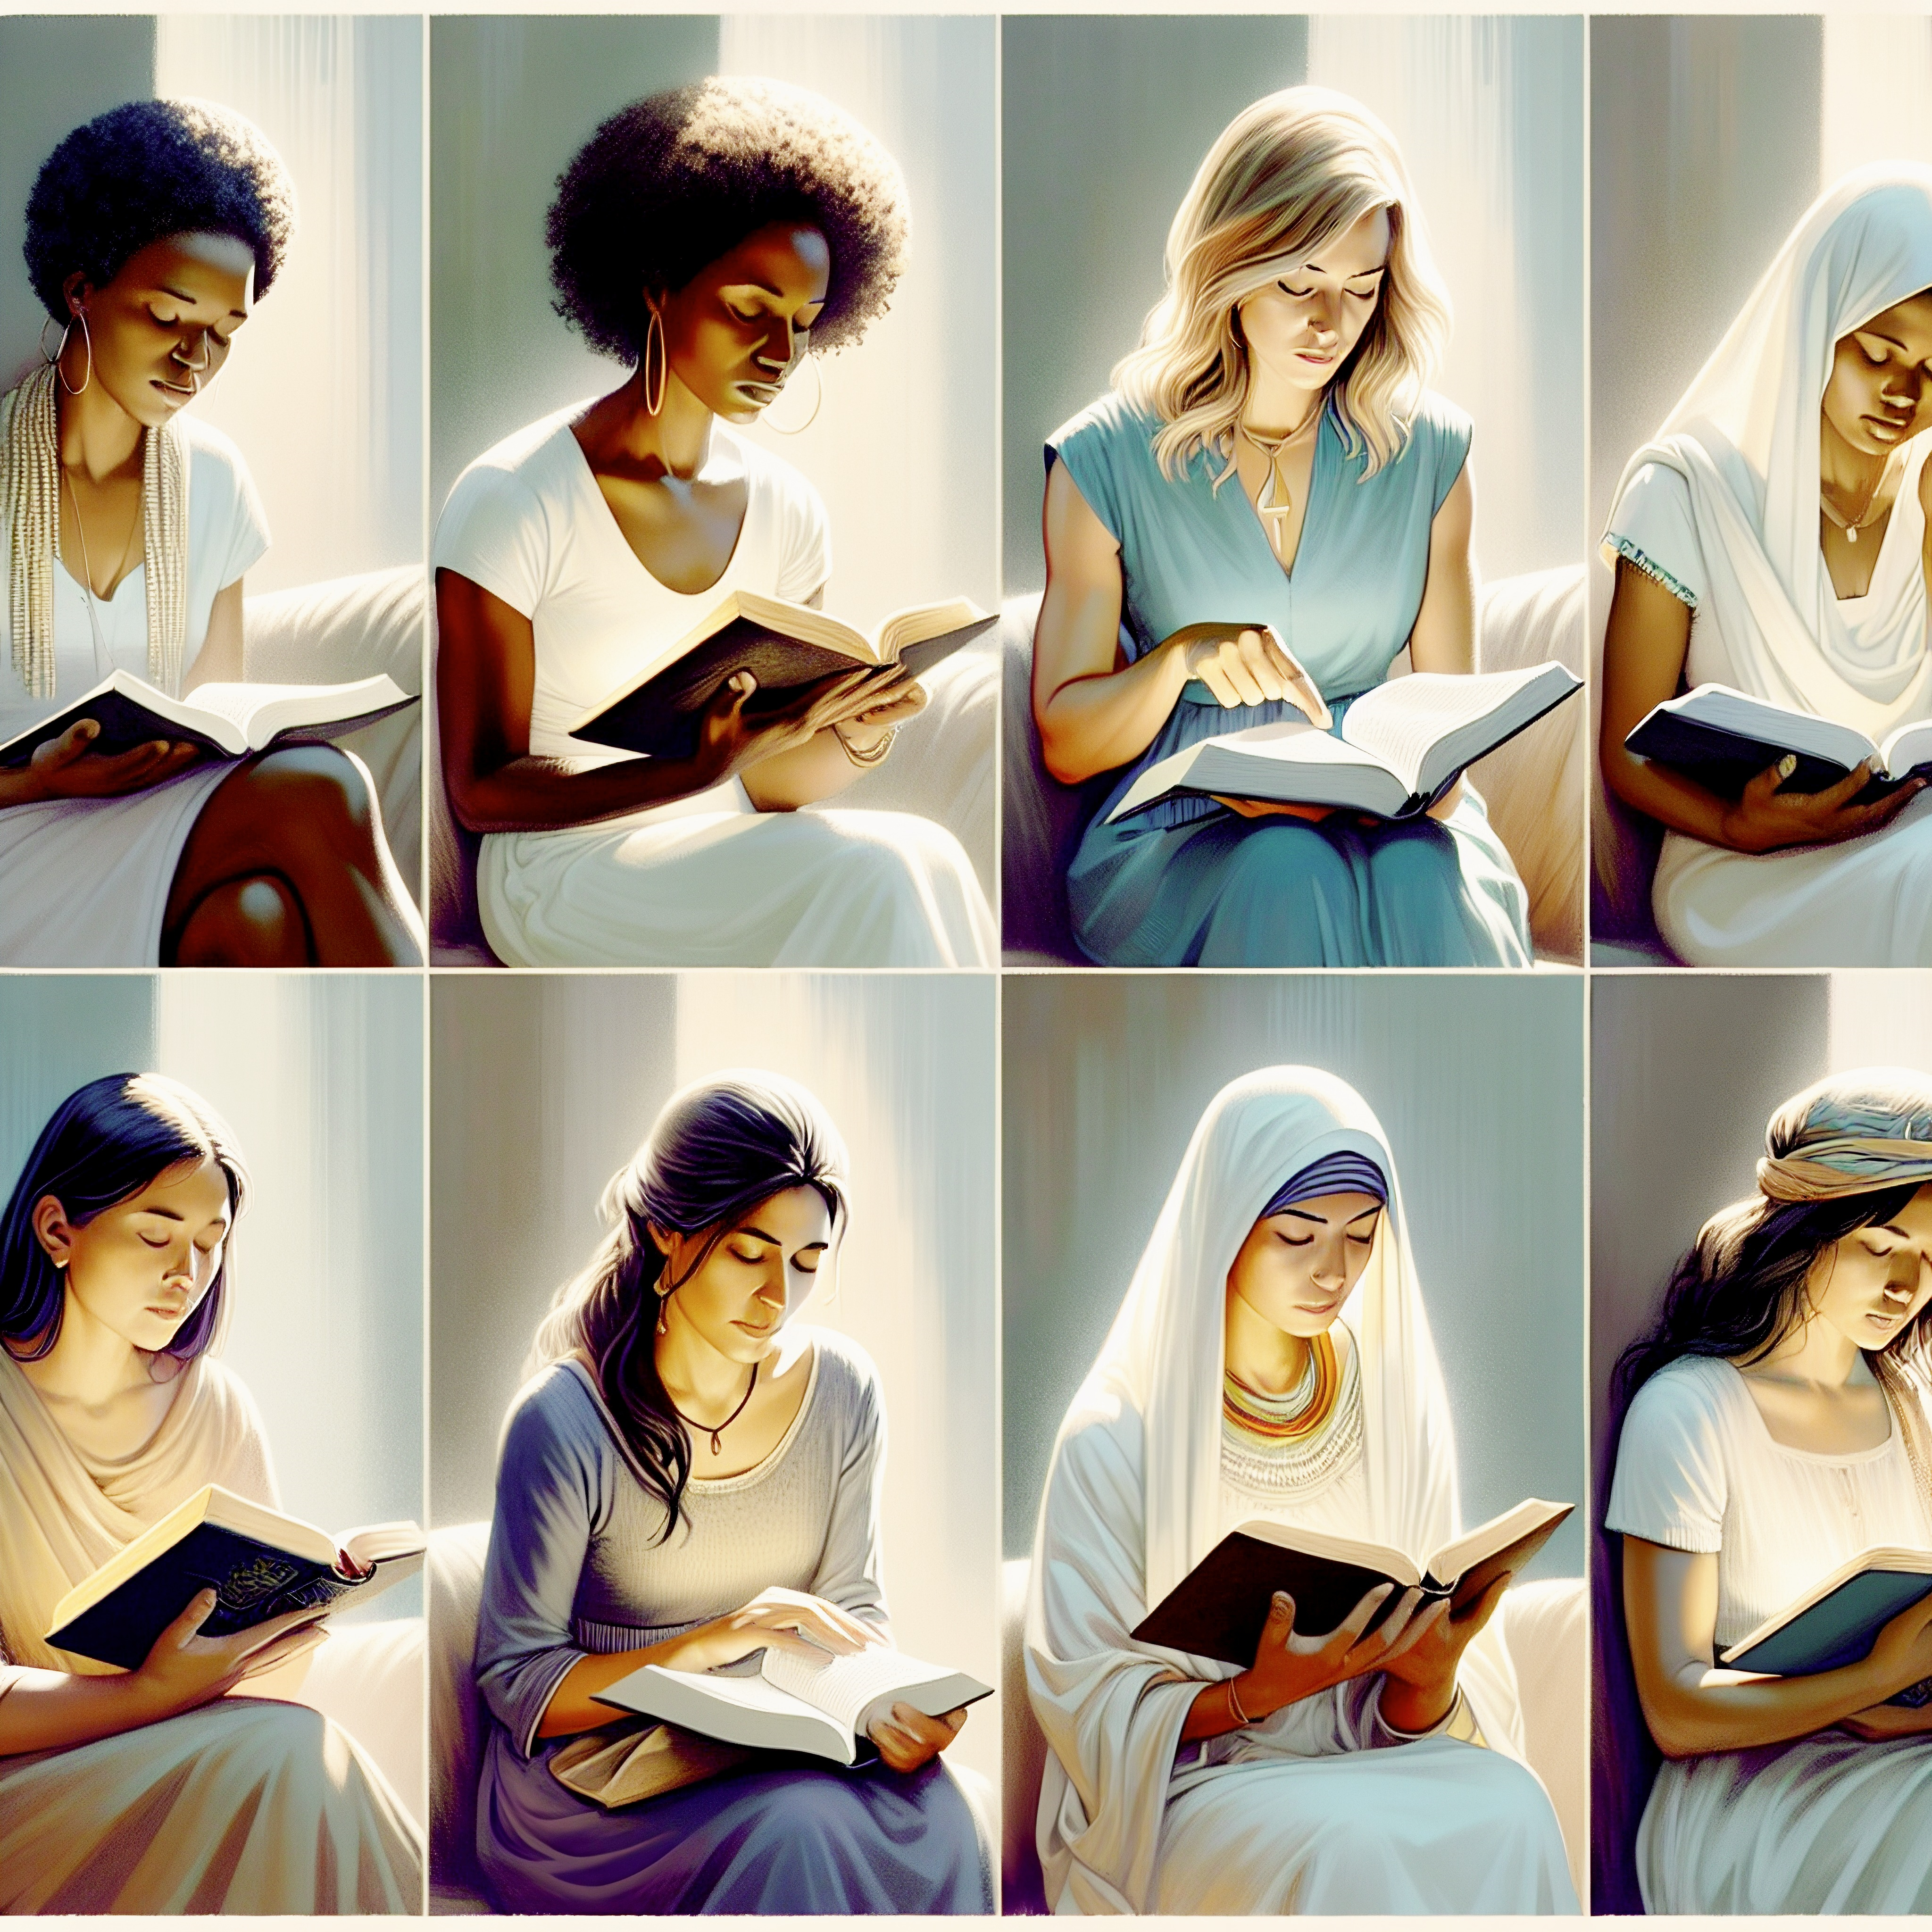
The Divine Role of Mothers in Saving the World
Luke 1:26-38
Notes:
Eddie Williams ~ May 10, 2026 (Eloy)

Slide 2
Luke 1:26-38 (NASB)
²⁶ Now in the sixth month the angel Gabriel was sent from God to a city in Galilee named Nazareth, ²⁷ to a virgin betrothed to a man whose name was Joseph, of the descendants of David; and the virgin's name was Mary.

Slide 3
Luke 1:26-38 (NASB)
²⁸ And coming in, he said to her, "Greetings, favored one! The Lord is with you." ²⁹ But she was very perplexed at this statement, and was pondering what kind of greeting this was.

Slide 4
Luke 1:26-38 (NASB)
³⁰ And the angel said to her, "Do not be afraid, Mary, for you have found favor with God.
³¹ "And behold, you will conceive in your womb and give birth to a son, and you shall name Him Jesus.

Slide 5
Luke 1:26-38 (NASB)
³² "He will be great and will be called the Son of the Most High; and the Lord God will give Him the throne of His father David; ³³ and He will reign over the house of Jacob forever, and His kingdom will have no end."

Slide 6
Luke 1:26-38 (NASB)
³⁴ But Mary said to the angel, "How will this be, since I am a virgin?" ³⁵ The angel answered and said to her, "The Holy Spirit will come upon you, and the power of the Most High will overshadow you;

Slide 7
Luke 1:26-38 (NASB)
for that reason also the holy Child will be called the Son of God. ³⁶ "And behold, even your relative Elizabeth herself has conceived a son in her old age, and she who was called infertile is now in her sixth month.

Slide 8
Luke 1:26-38 (NASB)
³⁷ "For nothing will be impossible with God."
³⁸ And Mary said, "Behold, the Lord's bond-servant; may it be done to me according to your word." And the angel departed from her.

Slide 9
1) Mothers’ Divine Role of Saving the World is Seen in Mary.
Spiritual characteristics of Mary, the mother of Jesus, are characterized by profound faith, humility, and strength, exemplified by her willing surrender to God's will. (Luke 1:38)
)
Scripture (version)

Slide 10
2) A Model of Obedience and Devotion.
She navigated extreme challenges with quiet courage, from the Annunciation from the angel Gabriel to witnessing the crucifixion.
(Luke 1:26-38 CSB)

Slide 11
John 19:25-27 (CSB)
²⁵ Standing by the cross of Jesus were his mother, his mother’s sister, Mary the wife of Clopas, and Mary Magdalene. ²⁶ When Jesus saw his mother and the disciple he loved standing there, he said to his mother, “Woman, here is your son.”

Slide 12
John 19:25-27 (CSB)
²⁷ Then he said to the disciple, “Here is your mother.”

Slide 13
Key Spiritual Characteristics of Mary Include:
Profound Humility and Meekness
Unwavering Faith and Trust
Quiet Strength and Courage

Slide 14
Luke 1:30 (NASB)
And the angel said to her, "Do not be afraid, Mary, for you have found favor with God.

Slide 15
3) The Challenges of Bearing the Savior, and the Profound Grief at the Cross.
"And behold, you will conceive in your womb and give birth to a son, and you shall name Him Jesus.
(Luke 1:31 NASB)

Slide 16
4) She is described as a woman who kept and pondered events in her heart, reflecting a deep spiritual inner life and meditation on God's works.
Luke 2:19 (NASB)

Slide 17
Luke 2:19 (NASB)
But Mary treasured all these things, pondering them in her heart.

Slide 18
5) A Worshipper of God:
She demonstrates that her spirit rejoiced in God her Savior, directing all praise to Him.
A Model of Intercession

Slide 19
Luke 1:46-48 (NASB)
⁴⁶ And Mary said: "My soul exalts the Lord, ⁴⁷ And my spirit has rejoiced in God my Savior.
⁴⁸ "For He has had regard for the humble state of His bond-servant; For behold, from now on all generations will call me blessed.

Slide 20
Mary is recognized as one of the greatest people in scripture, a devoted, loving and courageous figure whose life was wholly centered on fulfilling God’s purpose.

Slide 21
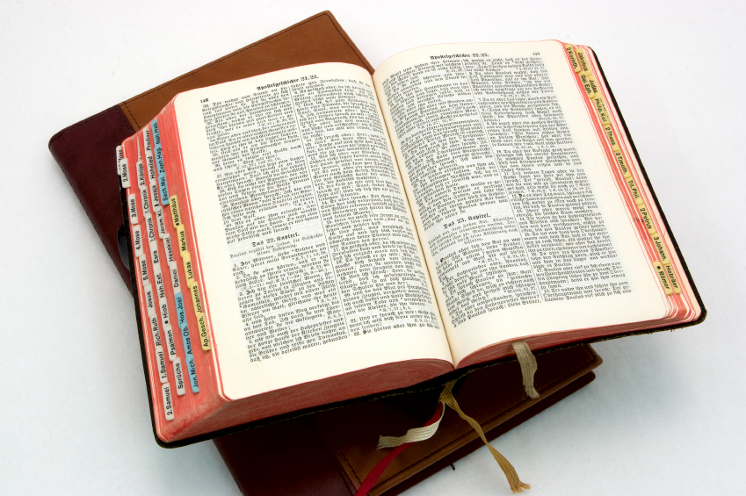
Hear: Romans 10:17
So then faith cometh by hearing, and hearing by the word of God.

Slide 22
Believe: Hebrews 11:6
But without faith it is impossible to please him: for he that cometh to God must believe that he is, and that he is a rewarder of them that diligently seek him.

Slide 23
Repent: Luke 13:3
I tell you, Nay: but, except ye repent, ye shall all likewise perish.

Slide 24
Confess: Matthew 10:32-33
32 Whosoever therefore shall confess me before men, him will I confess also before my Father which is in heaven.
33 But whosoever shall deny me before men, him will I also deny before my Father which is in heaven.

Slide 25
Baptize: Acts 22:16
And now why tarriest thou? arise, and be baptized, and wash away thy sins, calling on the name of the Lord.

